Slide 1



Standard and Customer Auditing Azure SQL Database
John Miner Data Architect
john.miner@bluemetal.com
Blog: www.craftydba.com www.mssqltips.com
Tweet: JohnMiner3

Slide 2
Target Audience
SQL Server Developers
How to use PowerShell to enable standard auditing using blob storage.
How to use T-SQL to create custom auditing patterns.
SQL Server Administrators
All the coding tricks of the developers.
How to setup security to hide any auditing constructs.

Slide 3
Business Problem
The process of classifying a company into an industry segment has been around since the 1950’s. Wikipedia has listed several popular taxonomies that are in current use.
Some industries are more regulated and have stricter compliance regulations than others. Two highly regulated industries are financial institutions and health care companies.
As a database administrator, how can we provide an audit trail to a compliance officer when a security issue has occurred?

Slide 4
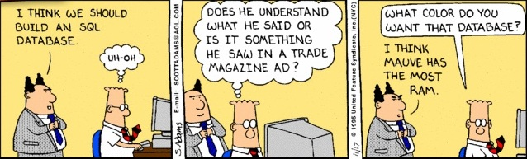
Some coding knowledge
I will be going over examples written in T-SQL and PowerShell. A basic understanding of the Azure Portal is required. I will not be offended if you leave my presentation now!

Slide 5
Presentation Overview
Enable standard auditing for batches.
Test standard auditing pattern 1.
Create custom auditing using table triggers.
Test custom auditing pattern 2.
Create custom auditing using database triggers.
Test custom auditing pattern 3.
Enable standard auditing for schema changes.
Test standard auditing pattern 4.

Slide 6
Sample HIPPA database
Create a very simple database schema for a fictitious urgent care center.
The database has three tables. Patients who arrive at the clinic, doctors who exam the patients and visit information which contains vitals and a overall diagnosis.
I forgot to mention that the Human Resources department at this center is very bad at recruiting qualified doctors. We have the top ten most evil doctors of all time on our payroll. Now you know why the center is nick named “The Last Stop”.
Example 1 – Create the database

Slide 7
Standard Auditing (SA)
The first version of Azure SQL database auditing required the developer to save the log entries to a TABLE STORAGE account.
Within the last year or so, all auditing has been converted to use a general purpose BLOB STORAGE account.
The Azure Portal can be used to view the log entries; However, PowerShell is the only way to define which action group and actions are captured.
This technology is based upon SQL AUDIT which is available in the on premise version of the database engine.

Slide 8
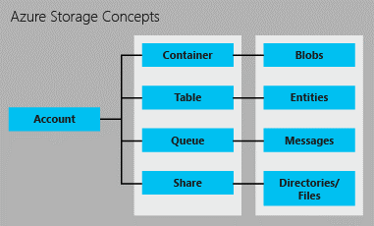
Azure Storage Concepts
Azure supplies the developer with many different storage concepts. Today, we are going to focus on blob storage.

Slide 9
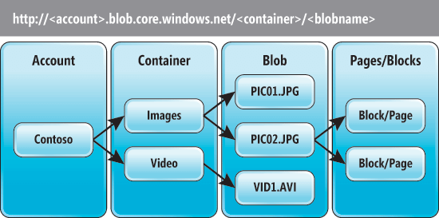
Azure Blob Storage
There is an hierarchy of objects when dealing with storage. A blob (file) resides in a container and a container resides in an storage account.
Hot, cool and archive storage tiers are now available but standard blob auditing works only with the general purpose tier.
Example 2 – Enable default auditing

Slide 10
Typical Auditing Concerns
There are two key pieces of information that we want to capture.
Identifying characteristics about who executed the action.
Details around the action so that we can reverse it if needed.
For data manipulation language statements (DML), we want to test select, insert, update and delete table data.
For data definition language statements (DDL), we want to test create, alter and drop schema objects.
Last but not least, for data control language statements (DCL) we want to test grant, deny and revoke.

Slide 11
Batch Completed (SA) - Test
PROS:
Easy to setup using PowerShell.
Captures detailed user information.
Captures TSQL statement.
CONS:
Does not capture record information.
Can not reverse action.
Example 3 – Test batch completed auditing

Slide 12
Table Triggers
Table triggers can be used to create a Custom Auditing (CA) design pattern.
Capture record information as XML
Store record information in log table
Reverse action using record information.
Table trigger can be used to prevent records manipulation. Security is the first defense against preventing unwanted actions. Triggers can be the second defense.

Slide 13
Table Triggers (CA) - Test
PROS:
Requires the usage of audit table.
Captures detailed user information.
Captures record information.
Able to reverse the action.
Can prevent actions.
CONS:
Does not capture which records in a select statement are viewed by the user.
Example 4 – Create and test table triggers.

Slide 14
Sample AUTOS database
Create a very simple database schema.
The database has two tables. The Continent table contains static data. The Cars By Country table contains statistics on the number of personal versus commercial vehicles.
We will be adding and modifying one new table. The idea is to see how table changes can be audited and/or prevented.
Example 5 – Create the database

Slide 15
Database Triggers
Database triggers can be used to create a Custom Auditing (CA) design pattern.
Capture DML statement
Store record information in log table
Database triggers can be used to prevent schema manipulation. Security is the first defense against preventing unwanted actions. Triggers can be the second defense.

Slide 16
Database Triggers (CA) - Test
PROS:
Requires the usage of audit table.
Captures TSQL statement.
Captures detailed user information.
Can prevent actions.
CONS:
Does not capture object information restoring.
* - This is a limitation of the current implementation.
Example 6 – Create and test database triggers.

Slide 17
Schema Change Action (SA) - Test
PROS:
Easy to setup using PowerShell.
Captures detailed user information.
Captures TSQL statement.
CONS:
Does not capture object state for reversing the action.
Can not prevent object deletion.
Example 7 – Test batch completed auditing

Slide 18
Missing Puzzle Piece
Table triggers can be used to create a Custom Auditing (CA) design pattern. However, you can not log which records are viewed by the user.
If you create user defined stored procedures for your CRUD actions, you can log which records in the Read procedure call that are sent back to the application.
Some on premise third party vendors such as Idera’s Compliance manager use a log reader technique to solve this issue. To date, I have not seen a vendor come up with an Azure equivalent.

Slide 19
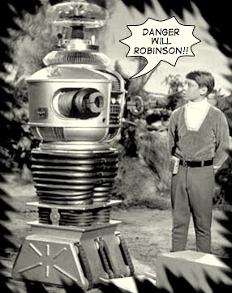
!! Warning Label !!
This is not a complete coverage of all the techniques involved.
I suggest you get familiar with how I solved this one simple problem.
Researching these topics will increase your knowledge and will allow you to solve more complex problems.

Slide 20
Summary
The same old techniques are being used to solve problems in Azure.
Standard auditing can be enabled using PowerShell scripting. This technology is based upon on premise SQL Server auditing. The *.xel file is stored in azure blob storage and can be viewed in the portal. This design pattern will satisfy basic auditing requirements.
Custom auditing can be designed and deployed using database objects and TSQL. Table triggers can be used to audit and prevent changes. Entries saved as XML records can be used to reverse unwanted actions. However, data viewed by the users select statement can not be tracked.
If you truly need to record who viewed what, consider using custom stored procedures.

Slide 21
References
Auditing using blob storage
https://www.mssqltips.com/sqlservertip/5180/azure-sql-database-auditing-using-blob-storage/
Auditing using table triggers
https://www.mssqltips.com/sqlservertip/5291/audit-and-prevent-unwanted-sql-server-table-changes/
Create Trigger
https://docs.microsoft.com/en-us/sql/t-sql/statements/create-trigger-transact-sql?view=sql-server-2017
Azure Blob Storage
https://docs.microsoft.com/en-us/azure/storage/blobs/storage-blob-storage-tiers
|

Slide 22
References (cont.)
SQL Server Audit
https://docs.microsoft.com/en-us/sql/relational-databases/security/auditing/sql-server-audit-database-engine?view=sql-server-2017
Audit Action Groups
https://docs.microsoft.com/en-us/sql/relational-databases/security/auditing/sql-server-audit-action-groups-and-actions?view=sql-server-2017
PowerShell – Set Audit Policy
https://docs.microsoft.com/en-us/powershell/module/azurerm.sql/set-azurermsqldatabaseauditingpolicy?view=azurermps-6.0.0
|

Slide 23
Biography
John Miner is a Data Architect at Blue Metal helping corporations solve their business needs with various data platform solutions. He has over twenty five years of data processing experience, and his architecture expertise encompasses all phases of the software project life cycle, including design, development, implementation, and maintenance of systems. His credentials include undergraduate and graduate degrees in Computer Science from the University of Rhode Island. He has also earned certificates from Microsoft for Database Administration (MCDBA), System Administration (MCSA) and Data Management & Analytics (MCSE). Before joining Blue Metal, John won the Data Platform MVP award in 2014 and 2015 for his outstanding contributions to the SQL Server community. When he is not busy talking to local user groups or writing blog entries on new technology, he spends time with his wife and daughter enjoying outdoor activities. Some of John’s hobbies include wood working projects, crafting a good beer and playing a game of chess.
|

Slide 24
Thank You
We look forward to working with you to manage business today and transform the future

